Slide 1

JS Back-End
Course Introduction
SoftUni Team
Technical Trainers
Software University
https://softuni.bg/

Slide 2
Table of Contents
Module Overview
Course Objectives
Training and Team
Course Organization

Slide 3
Have a Question?
sli.do
#js-web

Slide 4














SoftUni Diamond Partners

Slide 5

JS Web

Slide 6
JS Web Module Goals
3 months intensive JavaScript framework training
2 times weekly, lots of live coding and workshops
Part I - JS Back-End
Node.js, Express.js, MongoDB + Mongoose, JWT, Rest API
Part II – React JS
JSX, Components, Routing, Forms, React Hooks, Context API

Slide 7
Back-End Module - Timeline
12-Jan-2021
21-Feb-2021
14-Apr-2021
JS Back-End
6 weeks * 2 times / week
15 credits
Start: 12-Jan-2021
Theoretical Exam: 21-Feb-2021
Practical Exam: 21-Feb-2021
Re-Take Exams
Retake Practical: 14-Apr-2021
Retake Theoretical: 14-Apr-2021

Slide 8

Course Objectives

Slide 9
Course Objectives
Extend the skills, gained in JS Advanced, by introducing server-side JavaScript technologies
Learn to use the most common techniques in web development
Apply the fundamentals of application architecture and code convention through the MVC pattern
Requirements
HTML & CSS & JS (ES 2016) coding skills - intermediate level
Computer English - entry level

Slide 10

Course Topics
Introduction to Node.js
Node Streams & Utilities
ExpressJS & Templating
NoSQL & MongoDB & Mongoose
Session & Authentication
Validation & Error Handling
Workshop: Building a REST API

Slide 11

The Trainers Team

Slide 12
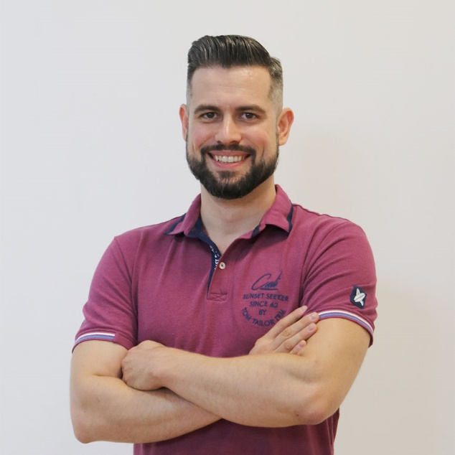
Ivaylo Papazov
Senior Full Stack and Team Lead @ Motion Software
Technical Trainer @ SoftUni
Experience in JS, C#, Node.js, React, ASP.NET MVC
TelerikAcademy Graduate

Slide 13

Course Organization

Slide 14
Practical Exam
Link to last Express.js Exam
Structure: Server-Side Rendering App for 4 hours
Implement CRUD operations + login / register / logout
Use Express.js + Handlebars (Pug, EJS…) and MongoDB

Slide 15
Theoretical Exam
You will have 30 minutes once you enter
Multiple-choice
English
Automated quiz system
Questions will be between 15 and 30
Available online on the day of the practical exam
You can submit your answers just one time

Slide 16


SoftUni Certificate
Practical Exam 100%
Homework 5%
Evaluation
16

Slide 17
CPE Certificate
Theoretical Exam 100%
Evaluation
17

Slide 18




Course Web Site, Forum and FB Group
Official web site:
Official discussion forum:
Official Facebook group:
Official SoftUni JavaScript Community:
softuni.bg/trainings/3223/js-back-end-january-2021
softuni.bg/forum/categories/107/
facebook.com/groups/jsbackendjanuary2021
facebook.com/groups/SoftUniJavaScriptCommunity/

Slide 19



Learn to Search in Internet
The course assignments require to search in Internet
This is an important part of the learning process
Some exercises intentionally have no hints
Learn to find solutions!
Software development includes everyday searching and learning
No excuses, just learn to study!
Developers learn new technologies, tools, languages every day!

Slide 20
Questions?
Notes:
20

Slide 21
Trainings @ Software University (SoftUni)
Software University – High-Quality Education, Profession and Job for Software Developers
softuni.bg
Software University Foundation
softuni.foundation
Software University @ Facebook
facebook.com/SoftwareUniversity
Software University Forums
forum.softuni.bg
Notes:
21

Slide 22

License
This course (slides, examples, demos, exercises, homework, documents, videos and other assets) is copyrighted content
Unauthorized copy, reproduction or use is illegal
© SoftUni – https://about.softuni.bg/
© Software University – https://softuni.bg
Notes:
22

